Slide 1

Keynote Address to the 2010 Annual Conference of the Northeastern Branch of the
Crop, Soil and Agronomy Societies of America
June 27, 2010
Cornell University
Global Agricultural Transitions In the Coming Generation:
Likely Market, Environmental and Humanitarian Impacts
Christopher B. Barrett

Slide 2
Overview
Agricultural demand and supply will evolve significantly over the coming generation.
These structural patterns will have major effects on:
prices, including price volatility
induced technological change
the natural environment
global food security and poverty.
On balance, farmers in the northeastern US should benefit from these structural changes.

Slide 3
Main Demand-Side Drivers
Demand Drivers
Population – slowing growth, especially in high-income nations, but still big absolute growth, almost all in developing countries.
Income Growth – especially in developing countries, with major implications for commodity composition of diets and trade.
Urbanization – especially in developing countries, market demand increases faster than aggregate demand as rural people migrate.

Slide 4
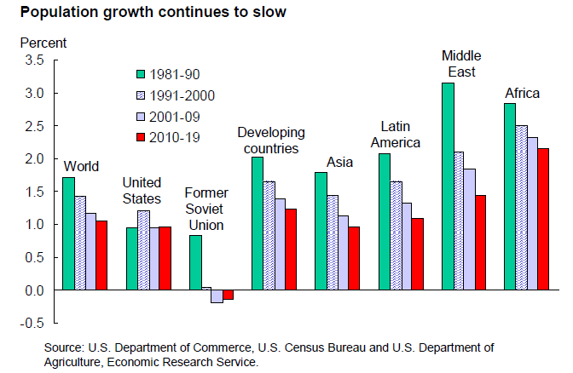
Demand Drivers
Notes:
Source: USDA Agricultural Projections to 2019. page 19. <http://www.ers.usda.gov/Publications/OCE101/OCE101.pdf> or depending on internet browser: < http://www.ers.usda.gov/publications/oce101/>
Asia, Africa and Latin America together will account for almost all population growth through 2025 with populations largely stagnant or even in decline in the developed world.
Strong global economic growth has contributed to declining global fertility rates, which has resulted in a declining rate of population growth
Global population growth is expected to average 1.1% annually 2010-19, compared to 1.4% annually in 1990s
Source: Guarneri, Christine and Ortman, Jennifer. “United States Population Projections: 2000 to 2050.” US Census Bureau. Page 7. <http://www.census.gov/population/www/projections/analytical-document09.pdf>
All estimates put the US population over 400 million by 2050, and the 2008 National Projection made by the US Census Bureau estimates the US population will be 443 million in 2050. The variation in estimates are caused by different estimates in the rate of positive net international migration.

Slide 5
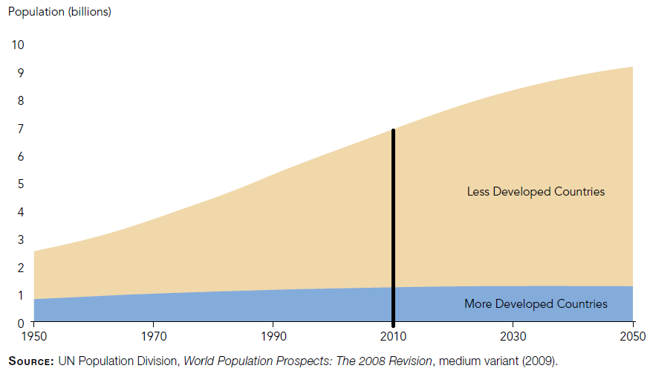
But large absolute growth
(due to population momentum), almost entirely in currently less developed countries
Demand Drivers
Notes:
Source: “2009 World Population Data Sheet.” Population Reference Bureau. <http://www.prb.org/pdf09/09wpds_eng.pdf>
Global total fertility rate in 2009: 2.6¹
2009 World Population: 6.8 billion¹
Projected to increase to 8.1 billion through 2025 and 9.1 billion in 2050¹ (2.3 billion more people than today)
Share of population in developing countries will increase to 84% of world total by 2019
Assumption in model: fertility rates will gradually continue to decrease in the developing world by mid-century to emulate the fertility rate in the developed world, which is below replacement fertility.
TFR in OECD as of 2004 was 1.63 children per women (Source: “Women and Men in OECD Countries.” OECD. <http://www.oecd.org/document/39/0,3343,en_21571361_38039199_38168231_1_1_1_1,00.html>). TFRs in developing world ranges from 2.4 in Latin America, to 3.1 in South Asia and the Middle East, and 5.4 in Sub-Saharan Africa using 2004 data. (Source: “2006 World Development Indicators.” The World Bank. <http://devdata.worldbank.org/wdi2006/contents/Section2.htm>)
Rapid population growth can and will continue to occur due to ‘population momentum,’ even if fewer children and smaller families become the global norm.
Source: “Fact Sheet: Population Growth and Poverty.” UNFPA. <http://www.unfpa.org/public/cache/offonce/factsheets/pid/3856#resources>

Slide 6
Real per capita GDP Growth
Demand Drivers
IMF forecasts for real per capita growth 2010-15:
US: 6.3%
All advanced economies: 9.5%
Emerging and developing economies: 21.5%
But initial scales trump growth rates in $ terms.
Notes:
Source: IMF World Economic Outlook April 2010, my calculations from GDP and consumer price series.
Developing economies are projected to rebound strongly from the financial crisis and grow on average 5.6% annually through 2019, compared to 2.2% annually in the developed world and the global average of 3.3% annually (page 17).
Annual GDP per capita growth in developing countries is expected to have averaged 3.7% from 2000 through 2015 and 4.4% thereafter through 2030. (Source: “World Agriculture: towards 2015/2030.” FAO. <ftp://ftp.fao.org/docrep/fao/004/y3557e/y3557e.pdf> Page 19.)

Slide 7
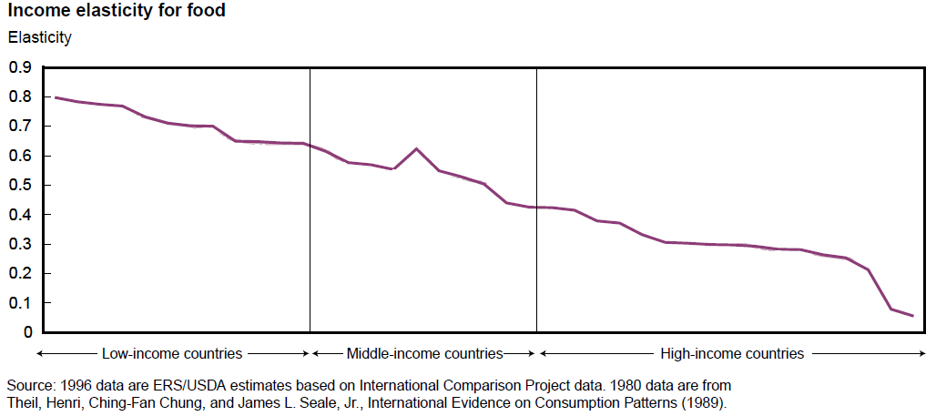
Income Elasticity for Food
Demand Drivers
But food demand grows at a decreasing rate with income growth. Marginal food demand growth due to income growth in low-income countries is 5-8 times that in US.
Notes:
Source: Deepak, James and Seale, Jason Bernstein. “Cross-Country Analysis of Food Consumption Patterns.” USDA ERS. <http://www.ers.usda.gov/publications/wrs011/wrs011d.pdf> Page 4, 7.
When incomes rise, poorer nations will increase food expenditures to a greater extent per marginal increase in income than will households in wealthier countries. Therefore, marginal income increases in poorer nations will create greater demand for food than would an equal marginal increase in income in a wealthy nation. Of all food subcategories, the greatest expenditure increase is on higher-value items such as dairy and meet which require greater resource inputs than similar caloric amounts of staple cereal crops. (page 6).
Raw data of food subgroups income elasticity from around the world in excel file (Source of the data: USDA, Economic Research Service, using the 1996 ICP data. From the ERS report Cross-Price Elasticities of Demand Across 114 Countries (TB-1925)).

Slide 8
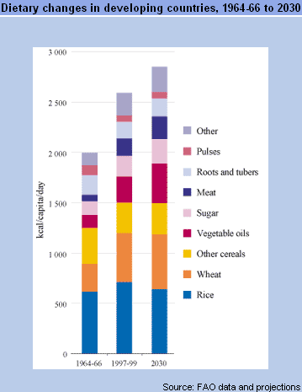
Changing Diets
Demand Drivers
Bennett’s Law: demand for variety and quality in diet grows with incomes.
Biggest shifts are in diet composition, especially oils, meat, dairy, sugar, fruits and vegetables.
More modest growth in demand for staple foods such as wheat, rice and other cereals.
Notes:
Source: “World Agriculture: Towards 2015/2030.” FAO. Taken from long term perspectives section
<http://www.fao.org/docrep/004/y3557e/y3557e06.htm#e>
Calorie consumption is expected to increase from 2681 kcal/capita/day in developing countries in 1999 to 2850 kcal/capita/day in 2015 and 2980 kcal/capita/day in 2030.

Slide 9
Urbanization increases the population share buying its food
Demand Drivers
Notes:
Source: “World Agriculture: Towards 2015/2030.” FAO. Taken from long term perspectives section
<http://www.fao.org/docrep/004/y3557e/y3557e06.htm#e>
Calorie consumption is expected to increase from 2681 kcal/capita/day in developing countries in 1999 to 2850 kcal/capita/day in 2015 and 2980 kcal/capita/day in 2030.

Slide 10
Over the coming generation, there will be significant growth in market demand for food.
Due mainly to population growth, especially in urban areas.
Growth disproportionately in developing countries and for higher value commodities.
Demand Summary
Notes:
Source: “World Agriculture: Towards 2015/2030.” FAO. Taken from long term perspectives section
<http://www.fao.org/docrep/004/y3557e/y3557e06.htm#e>
Calorie consumption is expected to increase from 2681 kcal/capita/day in developing countries in 1999 to 2850 kcal/capita/day in 2015 and 2980 kcal/capita/day in 2030.

Slide 11
Supply Drivers
Main Supply-Side Drivers
Land and water scarcity: Little untapped arable land and significant soil degradation in many regions, plus growing water scarcity limit capacity for expanding the agricultural frontier other than Africa/Latin America.
Climate Change: Shifting climate patterns – esp. volatility – force greater and changing trade patterns and reinforce North-South differences.
Technology: Slowing growth in yields. Rapid spread of biotechnology. Added pressure for new breakthroughs to address land and water scarcity as well as evolving pest and pathogen pressures, esp. with climate change.

Slide 12
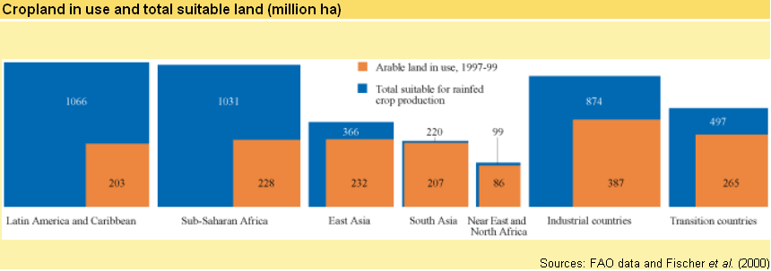
Arable Land
Supply Drivers
Only 0.4% growth in arable land from 1990-2007 (14.1 million km²).Essentially fixed without major (ecologically risky) conversion of forest, wetlands or drylands.
On a global scale, no land shortage for agriculture. But a real problem in certain regions.
Notes:
Source: FAO Stat. <http://faostat.fao.org/default.aspx>
Source: “World Agriculture: towards 2015/2030.” FAO. <http://www.fao.org/docrep/004/y3557e/y3557e08.htm#m>

Slide 13
Arable Land
Supply Drivers
80% of global agricultural land expansion expected in Africa/Latin America. Risks soil mining and stagnant or declining yields. Soil nutrient loss is already a serious challenge in many developing countries.
Urban expansion will compete with agriculture for prime land.
Increasing demand for biofuels also competes for prime agricultural lands as well as for food/feed crops. FAO estimates a tripling-quadrupling of land in biofuels (from 14 mn hectares in 2004 to 35-59 mn by 2030).
“Land grabs” in the developing world by emerging market investors (sovereign wealth funds, etc.) threaten to remove some lands from open market supply.
Notes:
Source: “World Agriculture: towards 2015/2030.” FAO. <http://www.fao.org/docrep/004/y3557e/y3557e08.htm#m>
Source: “The State of Food and Agriculture. Biofuels: prospects, risks and opportunities.” FAO. <ftp://ftp.fao.org/docrep/fao/011/i0100e/i0100e.pdf> Page 58.
USA production of ethanol is projected to increase to 52 billion liters by 2017, representing a doubling over 2004 levels.
“In 2004, an estimated 14 million hectares worldwide were being used to produce biofuels, representing about 1% of global cropland.” Page 74.
“US farmers harvested 30 million hecatres of maize in 2004, of which 11% was used for ethanol. In 2007, the area planted to maize in the USA increased by 19%.” Page 74.

Slide 14
Water
Supply Drivers
Globally, agriculture accounts for almost 70% of human water usage.
To keep pace with global food demand, annual freshwater withdrawals are estimated to increase by 14% over the next 30 years.
1 in 5 developing countries will face water shortages by 2030.
Notes:
¹ “Water at a Glance: the relationship between water, agriculture, food security and poverty.” FAO. Page 2.
² “Coping with Water Scarcity.” UN-Water Thematic Initiatives. August 2006. Page 5.
³ “World Agriculture: towards 2015/2030.” FAO. <http://www.fao.org/docrep/004/y3557e/y3557e08.htm#m>

Slide 15
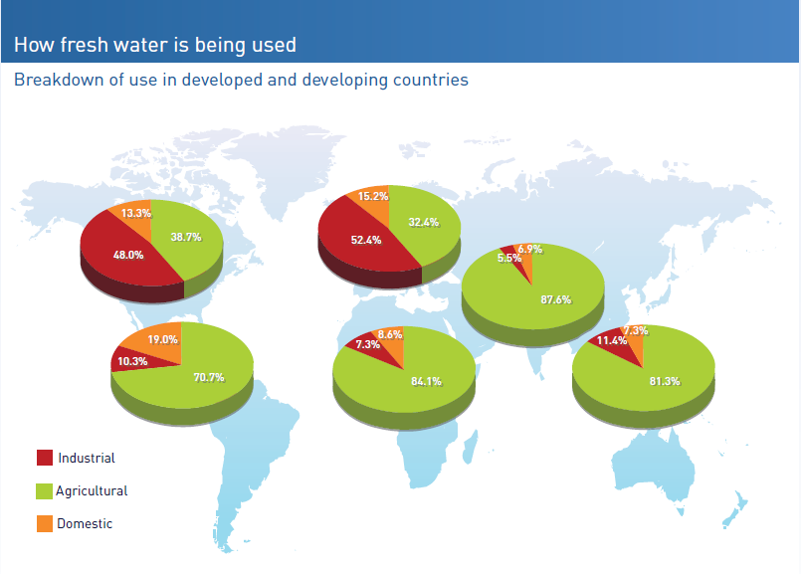
Supply Drivers
Notes:
Source: “Water at a Glance: the relationship between water, agriculture, food security and poverty.” FAO. Page 1.
Global average: close to 70% of water is used in agriculture but it varies by region. In Asia it is over four-fifths whereas it is only about one-third in Europe and two-fifths in the US.

Slide 16
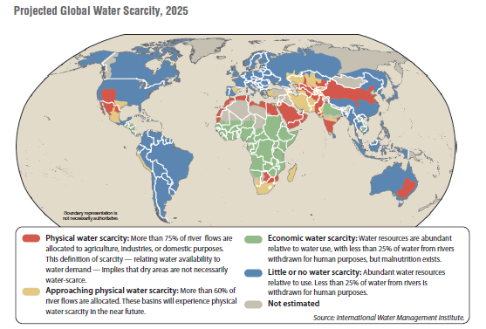
Supply Drivers
Notes:
Source: “Global Water Outlook to 2025.” International Food Policy Research Institute. (the map and barchart can be split up very easily)
This graph & report includes data on water consumption across regions (and growth), and relative water scarcity in different regions of world.

Slide 17
Climate Change & Agriculture
Supply Drivers
Northern Latitudes expected to benefit:
  Temperature increases more pronounced in northern temperate zones. Extends growing season, increases suitable cropping land, decreases costs associated with overwintering livestock, increases crop yields.
  Increased atmospheric concentrations of CO₂ will act as a natural fertilizer for crop production.
Tropics and Water-Scarce Regions at risk:
  Increased temperatures lead to increased evapo-transpiration and decreased soil moisture levels.
  Some tropical grasslands and cultivated areas will become increasingly arid and unsuitable for cropping.
Notes:
Source: “World Agriculture: towards 2015/2030.” FAO. <http://www.fao.org/docrep/004/y3557e/y3557e11.htm#t>

Slide 18
Climate Change & Agriculture (continued)
Supply Drivers
Increasing temperatures will expand the range of agricultural pests and milder winters will increase the ability of pest populations to survive
Higher temperatures will induce higher rainfall amounts, but rainfall distributions will not be even.
Greater inter-year volatility in rainfall.
Expected sea level rise will flood fertile, low-lying coastal lands and lead to greater inland seawater intrusions, contaminating freshwater supplies and agricultural land.
Climate change will reinforce food security differences between wealthier, temperate regions and poorer, tropical regions.
Notes:
Source: “World Agriculture: towards 2015/2030.” FAO. <http://www.fao.org/docrep/004/y3557e/y3557e11.htm#t>

Slide 19
Supply Drivers
Climate Change & Agriculture (continued)
Agriculture also affects climate change processes:
Agriculture contributes 10-12% of the total global anthropogenic emissions of greenhouse gases (GHGs)²
  47% of anthropogenic methane emissions
  58% of anthropogenic nitrous oxide emissions
Largest sources of agricultural emissions: agricultural soils, enteric fermentation
Other significant sources: biomass burning, rice production and manure management
Notes:
² Source: “Climate Change 2007: Working Group III: Mitigation of Climate Change.” IPCC Fourth Assessment Report: Climate Change 2007. <http://www.ipcc.ch/publications_and_data/ar4/wg3/en/ch8s8-3.html> Section 8.3

Slide 20
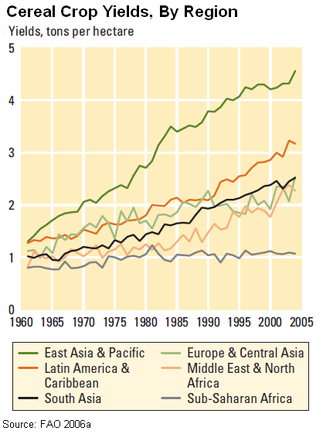
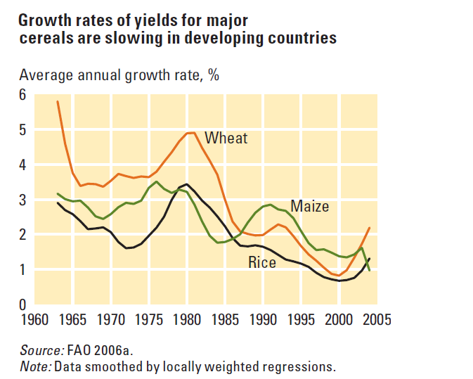
Agricultural technological change
Supply Drivers
Slowing rates of yield growth and uneven experience across regions.
Notes:
Source: “World Development Report 2008: Agriculture for Development.” The World Bank. <http://siteresources.worldbank.org/INTWDR2008/Resources/WDR_00_book.pdf>. Graphs on pages 71 and 87.
From “World Agriculture: toward 2015/2030”
1.) global cereal yields grew on average 2.5% in developing countries between 1961 and 1990
2.) growth in wheat yields are expected to average 1.1% annual growth from 2000-2030 (down from 3.8% per year between 1961 and 1989 and 2% a year from 1989 to 1999).
3.) growth in rice yields are expected to average 0.9% annual growth from 2000 through 2030 (down from 2.3% annual average growth between 1961 and 1989 and 1.1% from 1989 to 1999).

Slide 21
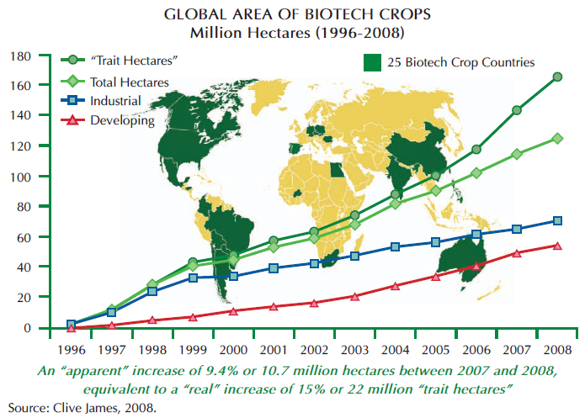
Rapid expansion and globalization of use of genetically modified crops
Supply Drivers
Notes:
Source: “Global Status of Commercialized Biotech/GM Crops: 2008.” ISAAA. <http://www.isaaa.org/resources/publications/briefs/39/download/isaaa-brief-39-2008.pdf>
Biotech/GM crops are concentrated in OECD and middle-income countries. US (62.5 million hectares), Argentina (21.0), Brazil (15.8), India (7.6) and Canada (3.8) – representing over 88% of world biotech/GM crop hectarage. (Page xi)
125 million hectares were planted globally of biotech crops in 2008, representing growth of 9.4% over the prior year and about 8% of the total 1.5 billion hectares of cropland worldwide. (Page xi)
Globally, there were 13.3 million biotech crop farmers at the end of 2008 of which 90% were “small and resource-poor farmers in developing countries.” This is an increase of 1.3 million farmers in 2008 alone. (Page xiv)

Slide 22
Over the coming generation, arable land and freshwater for agriculture grow increasingly scarce. Areas with greatest physical capacity for expansion face greatest water and land management challenges.
Climate change compounds these problems, especially due to coastal flooding and pest/pathogen pressures.
Slowing yield growth must be reversed. Technological change increasingly focuses on abiotic and biotic stresses related to climate change and water scarcity.
Supply Summary
Notes:
Source: “World Agriculture: Towards 2015/2030.” FAO. Taken from long term perspectives section
<http://www.fao.org/docrep/004/y3557e/y3557e06.htm#e>
Calorie consumption is expected to increase from 2681 kcal/capita/day in developing countries in 1999 to 2850 kcal/capita/day in 2015 and 2980 kcal/capita/day in 2030.

Slide 23
Market Impacts
Continued Growth in Agricultural Trade
Demand growth continues to outpace supply growth, especially in low-income countries, which increasingly become net food importers.
Greater global demand for agricultural trade due to geographic patterns of supply and demand growth as well as impacts of climate change.
Renewed pressure for a WTO Agreement on Agriculture and reduced domestic support and protection in the OECD
  $1 billion/day in OECD subsidies to agriculture!
  Far greater protection in agriculture (19%) than manufactures (4%) or energy (2%).
Notes:
Source: Laborde, Davide. “Assessing Applied Protection across the World.” Review of International Economics, 16(5), 850-863, 2008. <http://www3.interscience.wiley.com/cgi-bin/fulltext/120123875/PDFSTART> Access through Wiley InterScience.
Source: Laborde, David. “Food and Agricultural Trade: Implications for Food Security.” IFPRI. <http://www.slideshare.net/DLabordeD/food-and-agricultural-trade-implications-for-food-security>. #7

Slide 24
Market Impacts
Continued Growth in Agricultural Trade
Demand growth continues to outpace supply growth, especially in low-income countries, which increasingly become net food importers.
Greater global demand for agricultural trade due to geographic patterns of supply and demand growth as well as impacts of climate change.
Renewed pressure for a WTO Agreement on Agriculture and reduced domestic support and protection in the OECD
  $1 billion/day in OECD subsidies to agriculture!
  Far greater protection in agriculture (19%) than manufactures (4%) or energy (2%).
Notes:
Source: Laborde, Davide. “Assessing Applied Protection across the World.” Review of International Economics, 16(5), 850-863, 2008. <http://www3.interscience.wiley.com/cgi-bin/fulltext/120123875/PDFSTART> Access through Wiley InterScience.
Source: Laborde, David. “Food and Agricultural Trade: Implications for Food Security.” IFPRI. <http://www.slideshare.net/DLabordeD/food-and-agricultural-trade-implications-for-food-security>. #7

Slide 25
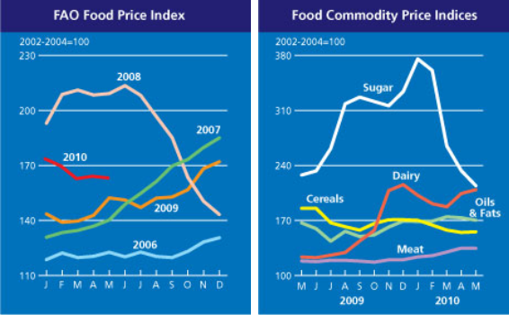
High and Volatile Commodity Prices
Market Impacts
Structural pressures of demand growth outstripping supply will lead to relatively high real prices. OECD forecasts prices stay 30-90% above 2004-5 levels.
Prices also remain volatile due to supply shocks (including from energy and financial markets).
Notes:
Sources: “World Food Situation.” FAO. <http://www.fao.org/worldfoodsituation/FoodPricesIndex/en/>
“Food Outlook: Global Market Analysis.” FAO. <http://www.fao.org/docrep/011/ai474e/ai474e15.htm>
Source: “OECD-FAO Agricultural Outlook 2010-2019.” <document in research folder> Page 33.

Slide 26
Induced Innovation
Market Impacts
Higher commodity and input prices will fuel greater private investment in improved agricultural technologies.
Higher and more volatile global market prices will also prompt greater FDI in developing country agriculture, much of which will close yawning yield gaps.
Renewed government commitments to agricultural development will begin to pay off in a decade or so, reigniting yield growth in low-income agriculture.
Demand growth is shifting agricultural value chains and inducing institutional innovation that boost productivity.

Slide 27
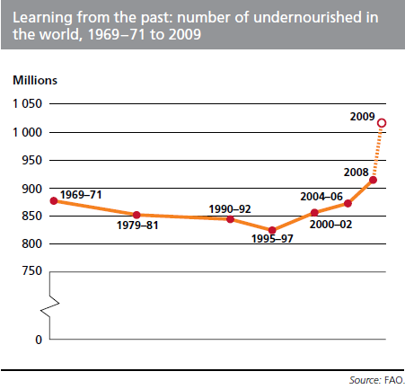
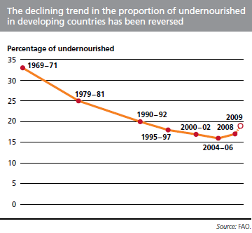
Humanitarian Impacts
Higher food prices and more frequent price spikes pose serious risks to the poor.
Notes:
Source: “The State of Food Insecurity in the World 2009.” FAO. <http://www.fao.org/docrep/012/i0876e/i0876e00.htm> Undernourishment around the world section. Page 4 (Report) 11 (PDF).
Source: “World Agriculture: towards 2015/2030.” FAO. <ftp://ftp.fao.org/docrep/fao/004/y3557e/y3557e.pdf>. Page 19.
Progress in reducing the hungry and undernourished will be slowest in Africa, with the greatest global density of the world’s hungry in 2030.
Undernutrition has negative effects on income & economic growth. It also increases necessary health spending per person while decreasing human productivity.

Slide 28
Micronutrient Deficiencies
Humanitarian Impacts
The problem is not just protein-energy undernutrition. Major micronutrient deficiencies worldwide are an even wider-scale and less visible challenge. Best addressed through income growth among the poor and productivity growth in higher-value commodities.
633 million individuals suffer from goiter (severe iodine deficiency)
  31% of developing world households do not consume iodized salt
100-140 million children are deficient in vitamin A, mainly in South Asia and sub-Saharan Africa
2 billion people are iron deficient, mainly women
Notes:
Source: “The Challenge of Hunger and Malnutrition.” Copenhagen Consensus 2008. Page 3.

Slide 29
Humanitarian Impacts
Persistent poverty and hunger are closely tied to agricultural stagnation
Cereal yields and extreme poverty move inversely.
Real GDP growth from agriculture is 2.7 times more effective in reducing extreme poverty vs. non-ag growth.
South Asian progress Sub-Saharan African stasis
Source: World Bank (2007)
Notes:
World Bank, World Development Report 2008.

Slide 30
Future Environmental Impact
Environmental Impacts
Greenhouse Gas Emissions
  Agricultural nitrous oxide emissions are projected to increase by 50% by 2020 relative to 1990 levels
  Combined methane emissions from enteric fermentation and manure management will increase by 21% by 2020 from 2005. Methane is 25x more powerful a GHG than CO₂.
Nitrogen Pollution
  Excess nitrogen from fertilizer spurs plankton growth, which decreases oxygen levels in the ocean. EPA has identified 150 dead zones worldwide. The biggest are the Baltic Sea and the Mississippi River Delta.
Notes:
Source: : “Climate Change 2007: Working Group III: Mitigation of Climate Change.” IPCC Fourth Assessment Report: Climate Change 2007. <http://www.ipcc.ch/publications_and_data/ar4/wg3/en/ch8s8-3-2.html> Section 8.3.2
Source: “World Environmental Year Book.” UNEP. <http://www.unep.org/yearbook/2009/PDF/UNEP_Year_Book_2008_EN_Full.pdf>
Source: “Investment and Financial Flows to Address Climate Change.” UNFCCC. <http://unfccc.int/files/essential_background/background_publications_htmlpdf/application/pdf/pub_07_financial_flows.pdf> Page 81.
Information was not provided on the carbon emissions that are emitted due to the land conversion to agriculture.

Slide 31
Future Environmental Impact
Environmental Impacts
Deforestation
  Agriculture accounts for ~80% of deforestation worldwide, almost 10 million ha/year: Commercial agriculture 32%, semi-subsistence farming 48%.
Water Use
  Necessary expansion of food production requires increased crop uptake of water.
  Since 70% of human water use is already on agriculture, this will both stress water availability and demand increased efficiency in water use, as well as potentially seawater desalination.
Notes:
Source: : “Climate Change 2007: Working Group III: Mitigation of Climate Change.” IPCC Fourth Assessment Report: Climate Change 2007. <http://www.ipcc.ch/publications_and_data/ar4/wg3/en/ch8s8-3-2.html> Section 8.3.2
Source: “Investment and Financial Flows to Address Climate Change.” UNFCCC. <http://unfccc.int/files/essential_background/background_publications_htmlpdf/application/pdf/pub_07_financial_flows.pdf> Page 81.
Information was not provided on the carbon emissions that are emitted due to the land conversion to agriculture.

Slide 32
Summary
Structural demand and supply patterns will have significant market impacts, largely favorable for growers in northeastern US.
But there are also major challenges looming.
In particular, growth in agricultural demand – especially in the developing world – will require accelerated technological progress in the developing world in order to avoid major humanitarian and environmental problems.

Slide 33

Thank you
Thank you for your time, interest and comments!

